Slide 1
LEGAL DEPARTMENT
Annex A
CEMEX HOLDINGS PHILIPPINES, INC.

Slide 2
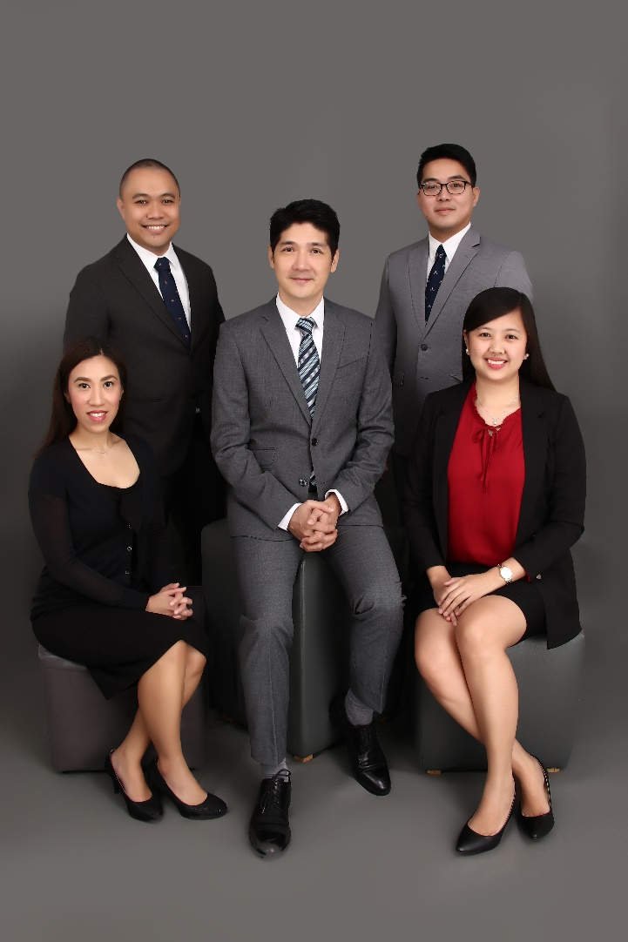
CEMEX PHILIPPINES - LEGAL DEPARTMENT
Organization and Profile

Slide 3


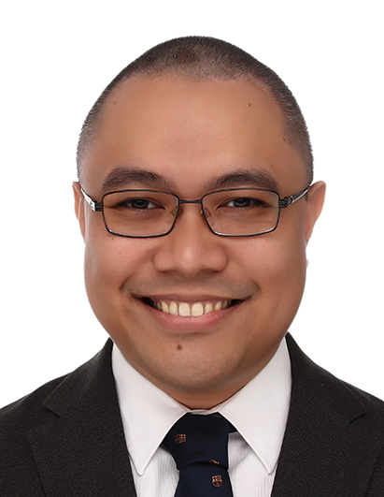


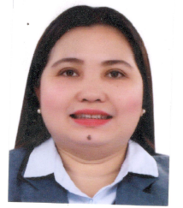
CEMEX PHILIPPINES - LEGAL DEPARTMENT
Organization
DINO SEGUNDO
Legal Director
KAREN OLIDAN
CHRISTER
GAUDIANO
MIGUEL BAYOT
VACANT
Legal Manager
Legal Manager
Legal Manager
Legal Manager
ANNE ASUNCION
Legal Assistant
JENNIFER CABELING
Paralegal

Slide 4
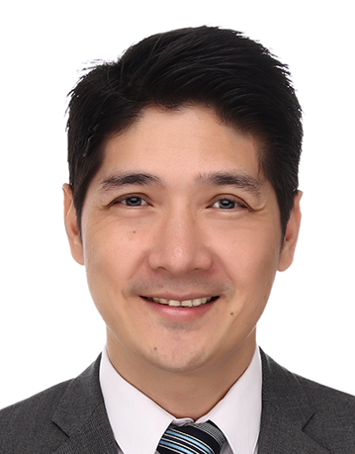
DINO MARTIN W. SEGUNDO
Legal Director
20 years in practice
EDUCATION
Bachelor of Laws
Bachelor of Arts, Major in Economics
WORK
Carag Caballes Jamora & Somera Law Offices
Soo Gutierrez Leogardo & Lee Law Offices
AREAS OF PRACTICE
Dispute Resolution
Litigation
Labor and Employment
Energy
Intellectual Property
Contracts
Commercial Law
Civil Law
Criminal Law
Administrative Law
Maritime Law

Slide 5
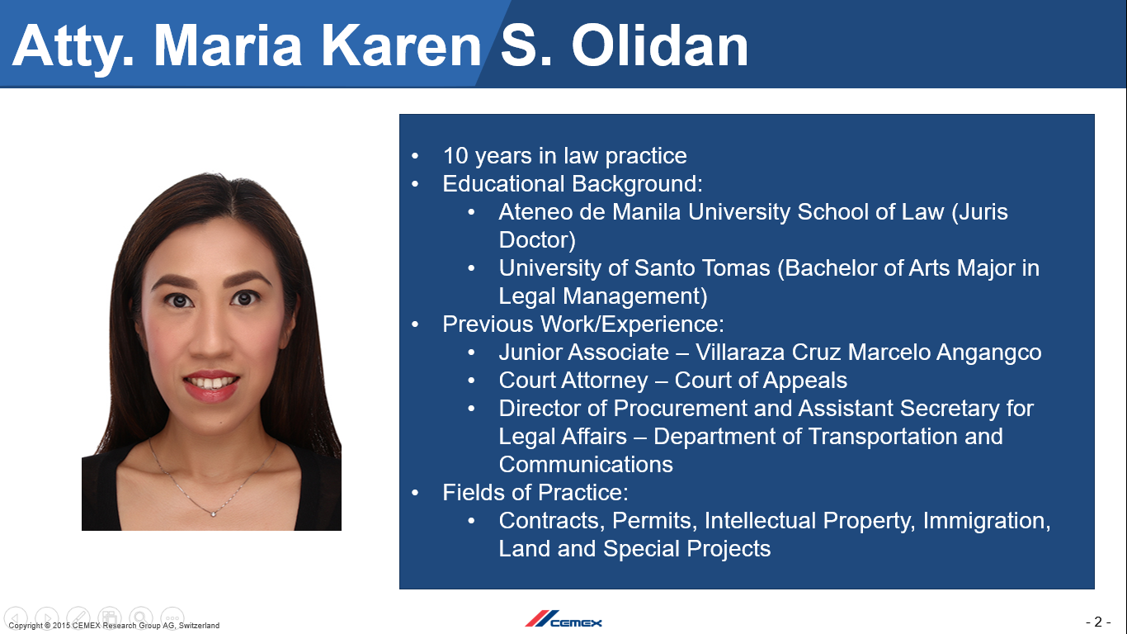
MARIA KAREN S. OLIDAN
Legal Manager
10 years in practice
EDUCATION
Juris Doctor
Bachelor of Arts, Major in Legal Management
WORK
Department of Transportation and Communication (Director - Procurement and Asec. - Legal Affairs)
Court of Appeals
Villaraza Cruz Marcelo & Angangco Law Offices
AREAS OF PRACTICE
Contracts
Government Permits
Transportation
Immigration
Intellectual Property
Land and Real Estate
Mining Law
Special Projects

Slide 6
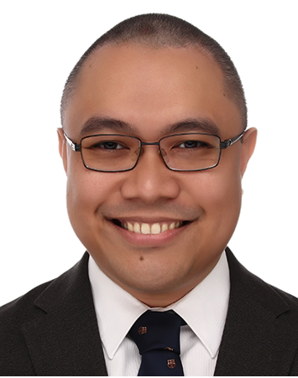
CHRISTER JAMES RAY A. GAUDIANO
Legal Manager
7 years in practice
EDUCATION
Bachelor of Laws
Bachelor of Arts, Major in Legal Management
WORK
Air Juan Aviation, Inc.
Department of Tourism (Director and Chief of Staff)
Office of the Solicitor General
Divina Law Offices
AREAS OF PRACTICE
Government and Regulatory Work
Aviation and Transportation
Litigation and Negotiations
Labor and Employment
Commercial Law
Contracts

Slide 7
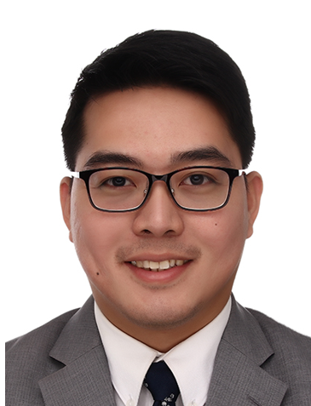
MIGUEL ROLANDO R. BAYOT
Legal Manager
5 years in practice
EDUCATION
Juris Doctor
Bachelor of Science, Major in Management Engineering
WORK
Puno & Puno Law Offices
Mannafoods, Inc.
AREAS OF PRACTICE
Energy
Corporation Law
Shipping and Transportation
Customs and Importation
Regulatory Work
Commercial Law
Contracts

Slide 8
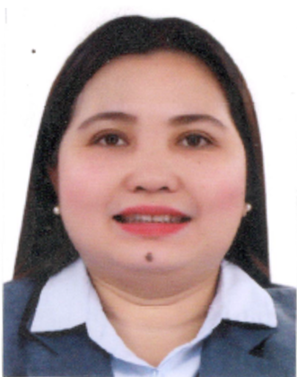
JENNIFER M. CABELING
Paralegal
EDUCATION
Bachelor of Laws
Bachelor of Arts, Major in Political Science
WORK
CEMEX Philippines
GENERAL FUNCTIONS
Paralegal Work
Administrative Support
Document Control
Government and Court Liason
Permits and License Monitoring
Assistance in Land Acquisitions
Legal Representative in Cebu

Slide 9
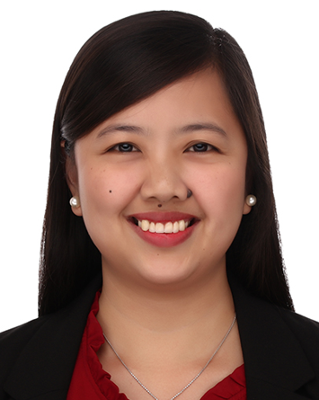
MARRIE ANNE A. ASUNCION
Legal Assistant
EDUCATION
Bachelor of Science, Major in Information Technology
WORK
Banco de Oro
GENERAL FUNCTIONS
Administrative Work
Paralegal Support
Docketing
Importation Immigration Documentation
Maintenance of Legal Calendar
Logistics Support

Slide 10
CEMEX PHILIPPINES - LEGAL
Services to Departments
PRESIDENT
AND CEO
CORPORATE
COMMUNICATIONS
HUMAN
RESOURCES
General legal advice and support
External and internal communications
Disclosures
Press releases
Community engagements
Competition and Policy
Labor disputes
Disciplinary proceedings
Contracts
Employee relations
Immigration
OPERATIONS, ENERGY,
SUPPLY CHAIN, PROCUREMENT
COMMERCIAL,
CUSTOMER EXPERIENCE
PLANNING, BSO, TAX
Contracts
Permits and licenses
Importation
Regulatory work
Dispute resolution
Special projects
Credit and Collection
Litigation
Contracts
Intellectual Property
Cemex Go
Contracts
Policy
Insurance
General legal advice and support

Slide 11
CEMEX PHILIPPINES - LEGAL
Mission and Vision
VISION: To be the best in-house Legal Team in the Philippines
MISSION:
EXCELLENT SERVICE
CONFIDENT CLIENTS
Deliver accurate, timely, relevant, practical, and ethical legal advice and service
Provide legal solutions that will empower internal clients to perform their work confidently and without distraction
PROTECTED COMPANY
SATISFIED LAWYERS
Render legal support always conscious of the overall well-being of the Company
Keep Team motivated, developed, and content by learning and succeeding together

Slide 12






CEMEX PHILIPPINES - LEGAL
How We Work
PRIORITIZING SAFETY
POLICY COMPLIANT
PRACTICAL AND EFFICIENT
Sharing of “Safety Moments”
VFL Participation
Health and Safety Policies integrated in contracts
Dispensing advice with CEMEX Policies in mind
Legal advice that solves problems
Legal advice designed to prevent problems from cropping up
Alternative dispute resolution over litigation
AGILE
ACCESSIBLE AND MOBILE
ACCOUNTABLE AND
RESPONSIBLE
Various fields of expertise
Systematized service
Collaborative work premium
Direct engagement with end-users
Team always reachable personally or through mail/mobile
Regular visits to all work sites
Full ownership over matters handled
Gatekeepers, and also last line of defense
Notes:
12

